Slide 1
Application Testing
Prof. Dr. Dirk Riehle
Friedrich-Alexander University Erlangen-Nürnberg
ADAP Y01
Licensed under CC BY 4.0 International
Notes:
It is Friedrich-Alexander University Erlangen-Nürnberg – FAU, in short.
Corporate identity wants us to say “Friedrich-Alexander University”.

Slide 2
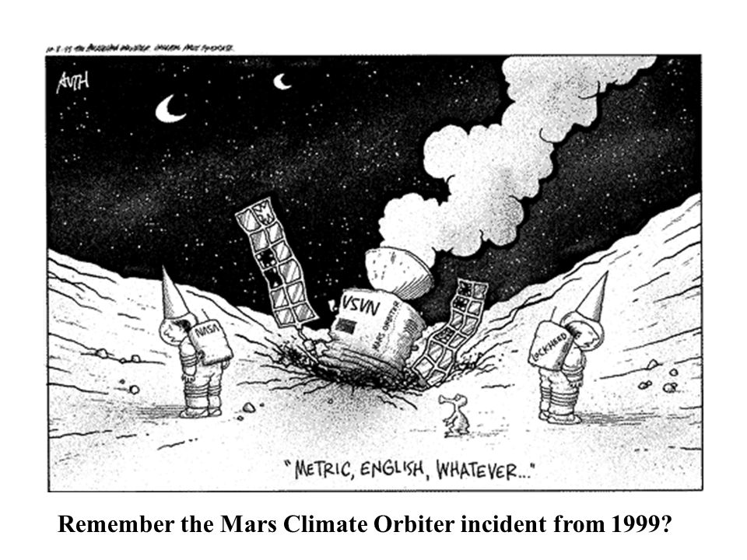

Software Defects
Software is omnipresent in our daily life
Bugs and errors in software can have grave consequences
https://slideplayer.com/slide/5829764/19/images/37/Remember+the+Mars+Climate+Orbiter+incident+from+1999.jpg
https://www.faz.net/aktuell/karriere-hochschule/campus/fehler-in-der-software-zehntausenden-studenten-droht-bafoeg-verspaetung-14403775.html

Slide 3
Why Testing Anyway?
Find failures and defects and prevent them reaching the production version
Check if item under test works as one expects
Reduce level of risk of inadequate software quality
Check if requirements have been satisfied
Gain confidence in the quality of the item under test
Comply with legal or contractual requirements or standards

Slide 4
Simple Development Cycle
edit
Edit = developer implements new feature
  Iterates over the code until it looks right
Compile = developer compiles the code
  Iterates over the code until it compiles (no syntax error)
Build = developer puts classes, build path together
  Packages application
Test = developer tests the program
  Keeps going until “behavior looks right” i.e. no bugs
Commit = developer commits to code repository
  May trigger a CI pipeline
compile
build
test
commit

Slide 5
Testing is a Process
In larger projects testing needs to be
governed by a process
  Planning and managing the test process
  Analysing which tests are necessary and designing them
  Implementing the tests and executing them
  Evaluation of test results and reporting
  Learn for the future
Start
Planning and
Management
Analysis and Design
Implementation and
Execution
Evaluation and
Reporting
Conclusion
Spillner, A., Linz, T.:
Basiswissen Softwaretest,
dpunkt, 4. Auflage
End

Slide 6
Static vs. Dynamic Testing
Static testing
  No execution of the software necessary
  Static code analysis
  Reviews
    of code
    of diagrams
    of documents, e.g. requirement specification
Dynamic Testing
  Testing at run-time of a software

Slide 7
Test Levels
Components tests (a.k.a. unit tests)
  Focus on testing one component out of context
Integration tests
  Focus on the collaboration of different components
System tests
  Focus on the system as a whole
Acceptance tests
  Focus on customer and end user experience
Requirement
Specification
Acceptance
Testing
Functional
Specification
System
Testing
Technical
Specification
Integration
Testing
Program
Specification
Component
Testing
Coding

Slide 8
Test Types
Functional testing (a.k.a. Blackbox Testing)
  Tests against functional requirements
  Tests the behaviour that is visible to the outside world
Non-functional testing
  Tests against non-functional requirements
  E.g. performance, stress, usability, portability requirements
Structure-based testing (a.k.a. Whitebox Testing)
  Tests against internal structure of component or system
  Goal is to cover all elements of the spectated structure
Testing related to changes
  Retests after a bug was fixed to ensure the fix
  Regression testing after any changes on the software

Slide 9
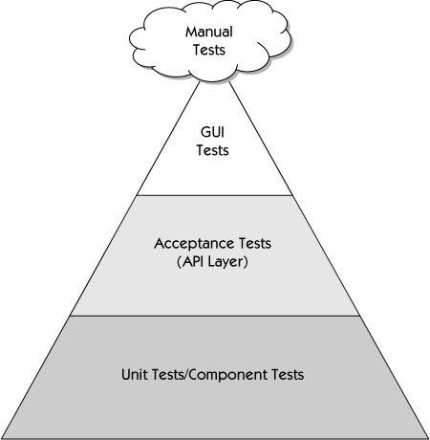
Test Automation Pyramid
Try to automate as much as possible
Manual testing
  takes time that can be saved by automation
  is not as reliable as programmed tests
  tends to be selective, not comprehensive
But:
  Human intuition can see problems that computers cannot
  Some things can’t be automated
    e.g. usability tests
more isolation
faster
Janet Gregory, Lisa Crispin: Agile Testing – A Practical Guide for Testers and Agile Teams (2008)

Slide 10
7 Software Testing Principles
Testing shows the presence of defects
    “Program testing can be used to show the presence of bugs, but never to show their absence!” – Edsger W. Dijkstra, 1970
Exhaustive testing is not possible
    E.g. input field for emails: can we test each input?
Start testing early
    The earlier we find defects (e.g. in the requirement analysis phasis) the less the costs for fixing them
Testing is context-dependent
    Safety-critical systems are differently tested than apps!
5) Defect clustering
    Pareto principle: 80% of problems are found in 20% of the modules
6) Pesticide paradoxon
    Just retrying tests has no benefits. Test cases have to be reviewed and revised.
7) Absence of error
    If tests find no defects, there still might be some in the system!

Slide 11
Testing Terminology
Test (Case)
  A single test for some particular aspect of the software, succeeds or fails
Test Suite
  A set of related tests that cover a particular domain of the software
Test Set-up
  The data and preparation necessary to run a test as intended
Test Result
  The result of running a test, typically succeeds/fails or error
Test Harness
  A software, like JUnit, that is used to run test suites

Slide 12
Thank you! Questions?
dirk.riehle@fau.de – http://osr.cs.fau.de
dirk@riehle.org – http://dirkriehle.com – @dirkriehle
DR

Slide 13
Credits and License
Original version
  © 2019 Friedrich-Alexander University Erlangen-Nürnberg and Dirk Riehle, all rights reserved
Contributions
  Georg Schwarz (2019)

